Slide 1
R-releases:
A community-curated R universe of package releases
Will Landau and Charlie Gao, with help from Jeroen Ooms

Slide 2
Motivation: competing priorities
VS
1. User experience
2. Maintainer experience
Packages must work on multiple platforms.
Packages must stay compatible with their dependencies.
Incentivize proper testing.
Publish updates in a timely manner.
Make progress on a package and its dependencies concurrently.
Notes:
CRAN archival after 2 weeks does not solve either problem.

Slide 3
R-releases: a way to get the best of both
+
1. User experience
2. Maintainer experience
A single universe to install any registered package.
Protect against broken or incompatible packages without a two-week delay.***
If a package release updates, its version number should always increment.
Each maintainer controls their own releases on GitHub/GitLab.
Registration with R-releases is easy:
Only needed once per package.
Completely automated for almost all packages.
Manual reviews require minimal effort.
Manual reviews are held to a consistent standard.
***Not implemented yet, but definitely feasible and on the roadmap.

Slide 4
R-universe: a recap

Slide 5

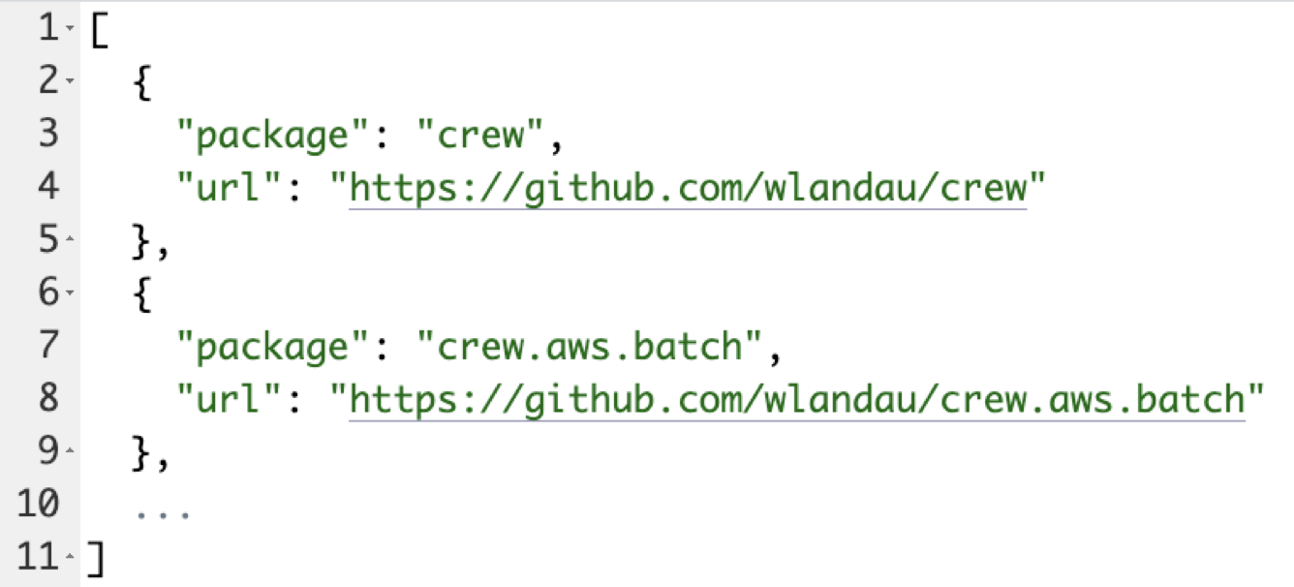
R-universe recap: personal package repositories
1. packages.json
https://github.com/wlandau/wlandau.r-universe.dev

Slide 6

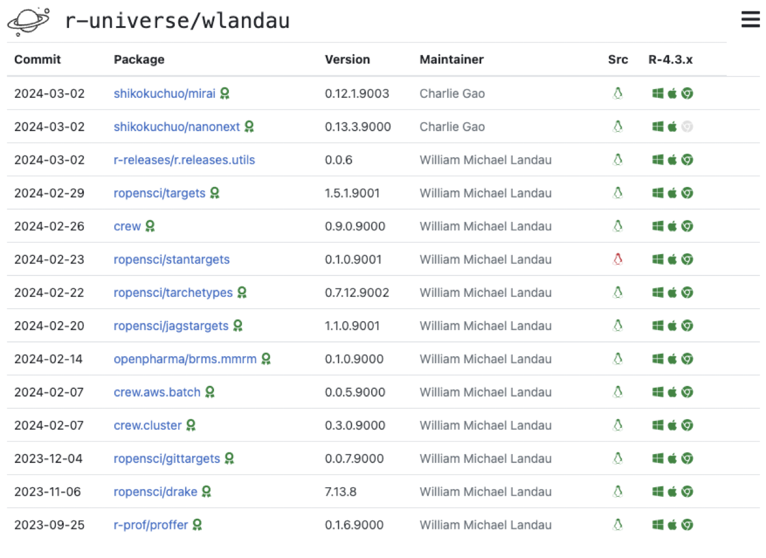
R-universe recap: personal package repositories
1. packages.json
2. The universe
https://github.com/wlandau/wlandau.r-universe.dev
https://wlandau.r-universe.dev

Slide 7

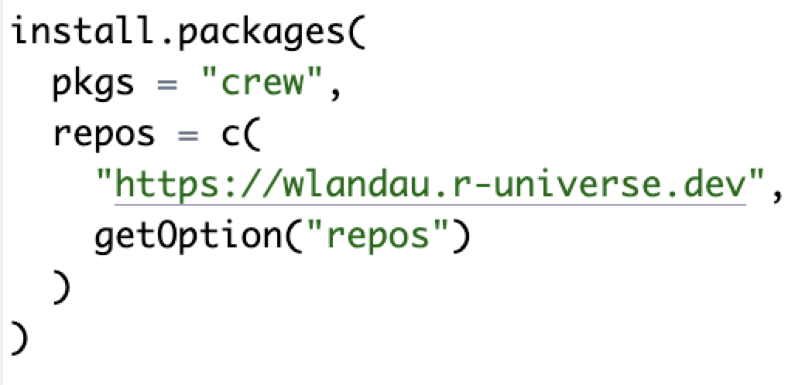
R-universe recap: personal package repositories
1. packages.json
2. The universe
3. Install packages
https://github.com/wlandau/wlandau.r-universe.dev
https://wlandau.r-universe.dev
Local R session

Slide 8
How R-releases uses R-universe

Slide 9
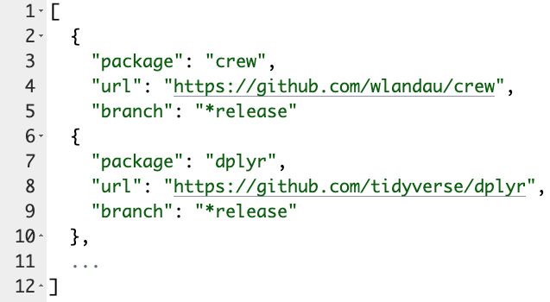
1. Track releases.
https://github.com/wlandau/wlandau.r-universe.dev
Notes:
Charlie first noticed this is possible.

Slide 10


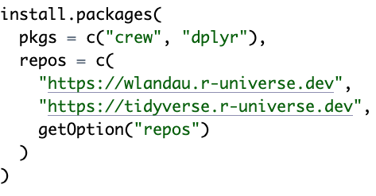
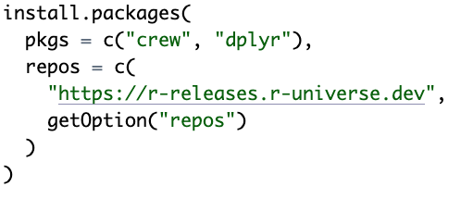
2. Collect releases across many GitHub owners.
https://wlandau.r-universe.dev
https://r-releases.r-universe.dev
https://tidyverse.r-universe.dev

Slide 11
How to register packages with R-releases

Slide 12
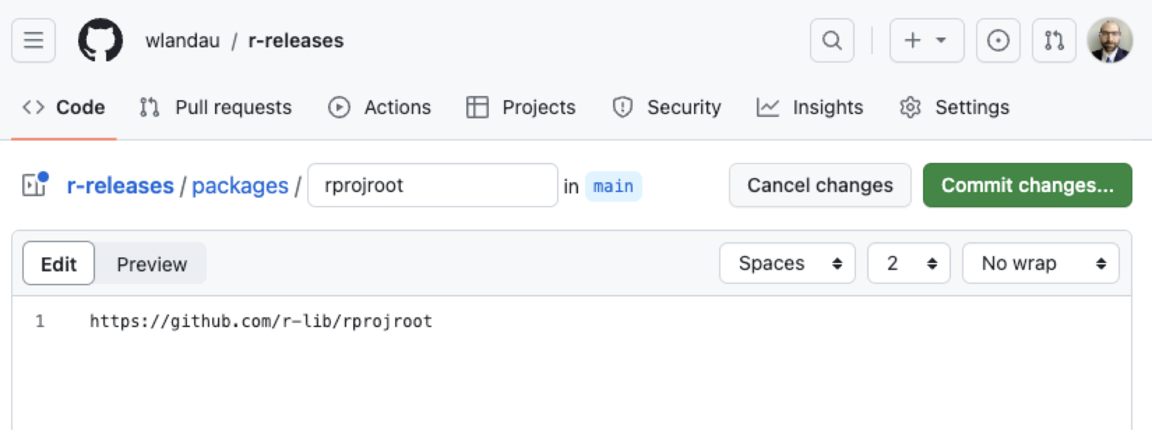
1. Fork and pull https://github.com/r-releases/r-releases
***Just write the URL

Slide 13
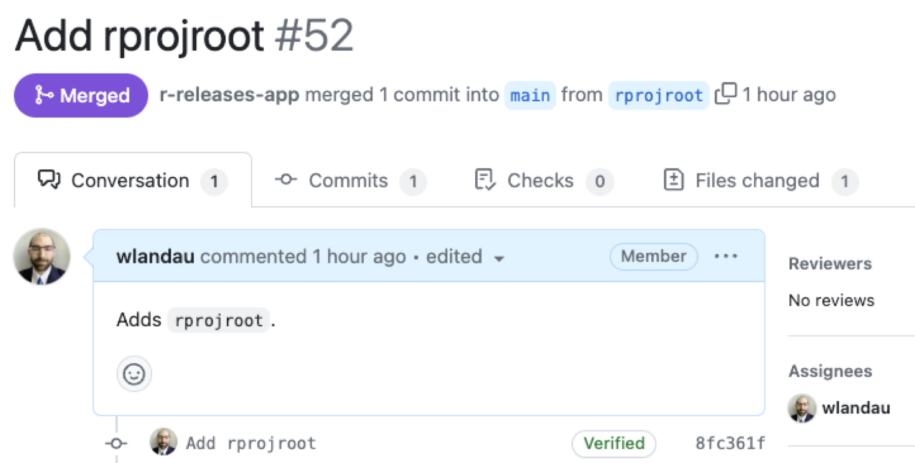
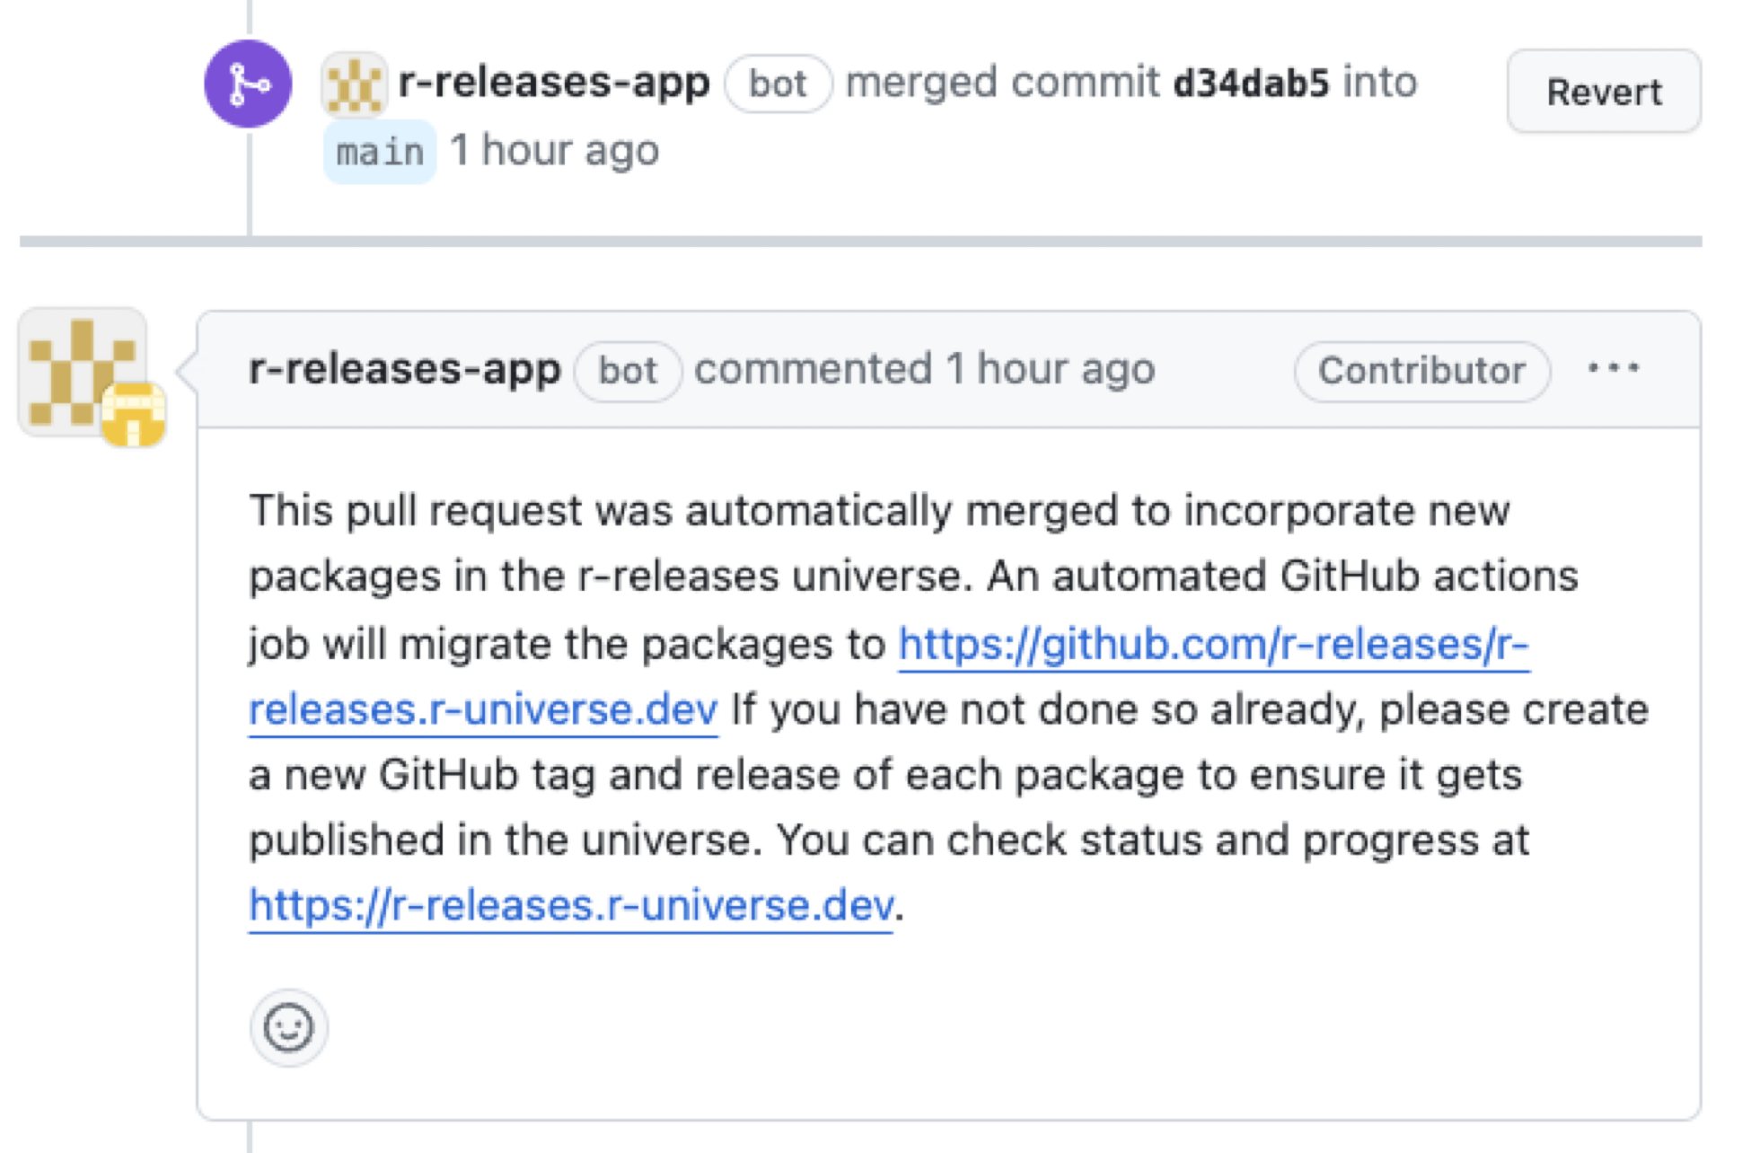
2. A bot validates the URL and merges the pull request.
https://github.com/r-releases/r-releases/pull/52

Slide 14
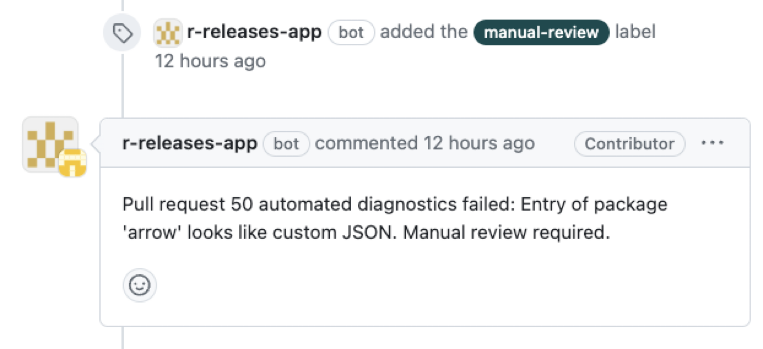
2. (Checks are strict.)
https://github.com/r-releases/r-releases/pull/50

Slide 15
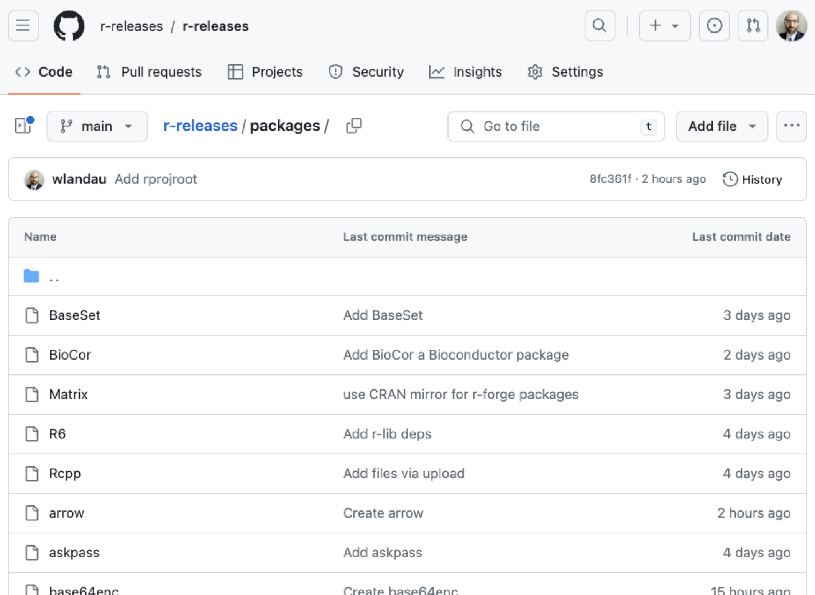
3. Package listings accumulate
https://github.com/r-releases/r-releases/tree/main/packages

Slide 16
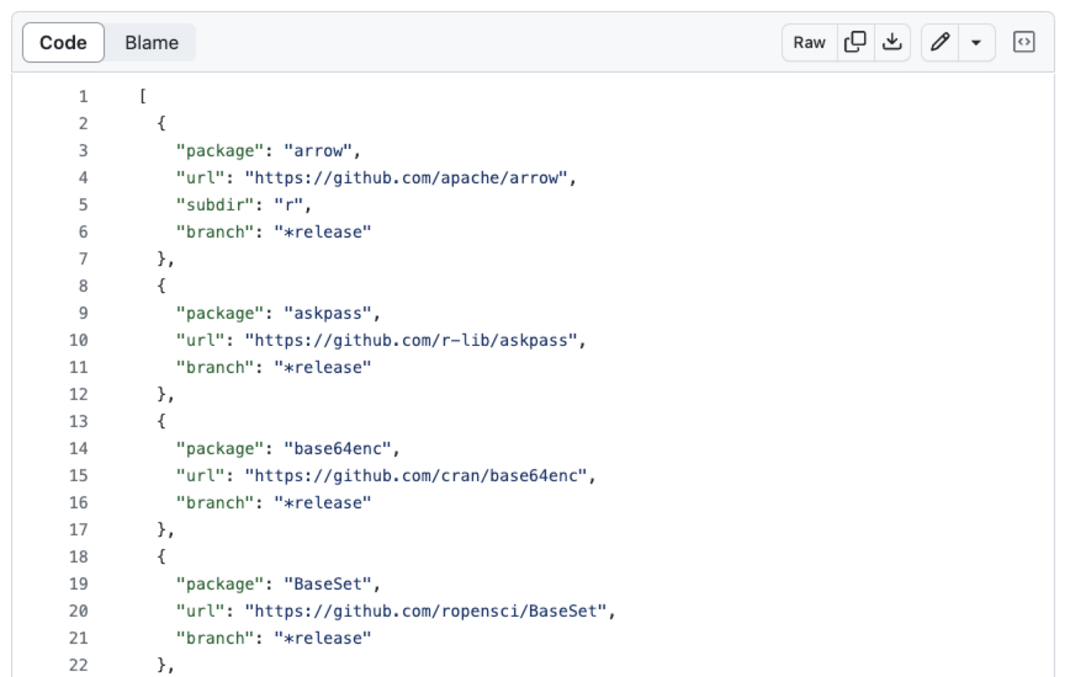
4. A workflow continuously build packages.json
https://github.com/r-releases/r-releases.r-universe.dev/blob/main/packages.json

Slide 17
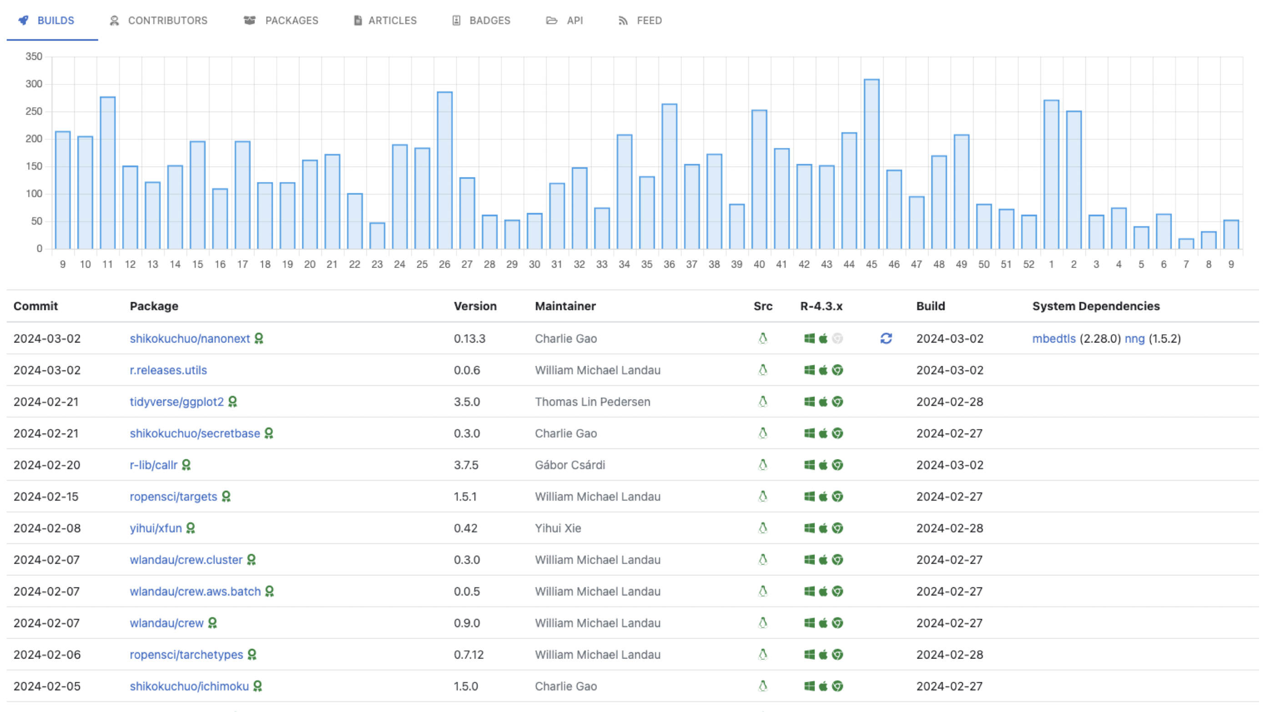
5. The universe continuously builds
https://r-releases.r-universe.dev

Slide 18
6. Users install package releases from one place

Slide 19
Development plan for R-releases

Slide 20
R-releases development plan
Feature requests for R-universe:
An API to get package check results: https://github.com/r-universe-org/help/issues/370
Trigger package checks when a dependency updates: https://github.com/r-universe-org/help/issues/369.
Equivalent to continuous reverse dependency checks.
Guardrails for users: https://github.com/r-releases/help/issues/6
install_safe(): exclude packages with failing checks.
Show the checks of selected packages.
(Alternative: a more selective universe downstream of r-releases: https://github.com/r-releases/help/issues/10)
Detect the packages whose version numbers did not increment in the latest release: https://github.com/r-releases/help/issues/21
Grow the R-releases universe.
Register more packages.
Make the dependency graph independent from CRAN.
Recruit moderators (selectively).

Slide 21
Thanks
Jeroen Ooms
Charlie Gao
Lluís Revilla
Gabe Becker
Joe Rickert

